Slide 1
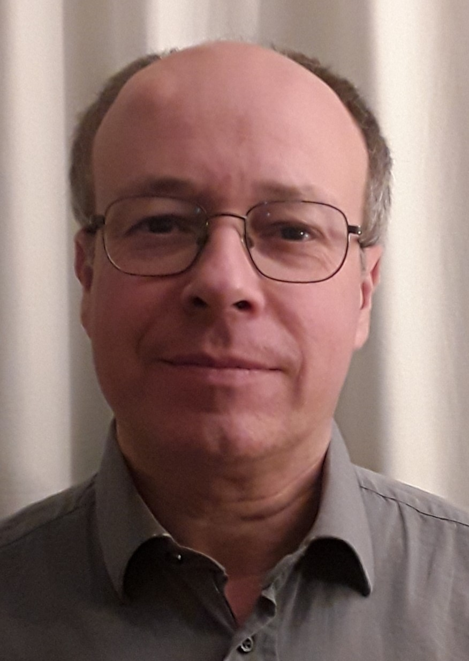
C³ Lecture
Aula II – 15:00
Dipartimento di Chimica «Giacomo Ciamician»
Via Selmi 2 , Bologna
28th October 2022
"Hydrogenation in the fine chemical industry"
Based on the personal experience of the speaker, the seminar aims at an overview of the economic, technical, intellectual property and sustainability factors that drive the applications of hydrogenation (heterogeneous, homogeneous) in the fine chemical industry (pharma, agro, F&F)
Dr. Antonio Zanotti-Gerosa
Director of the Homogenous Catalysis Group Johnson Matthey @ Cambridge
TEAMS LINK
Chair: Prof. Marco Bandini & Dr. Jacopo Roletto
Contacts: marco.bandini@unibo.it; segreteria.c3@unibo.it; https://centri.unibo.it/c3/en

